Slide 1

Minor Project ONLINE FOOD ORDERING WEBSITE
DAYANANDA SAGAR
UNIVERSITY
Under the guidance of
Dr. Vasanthi Kumari P
Notes:
nandini

Slide 2



Team Members
Avantika
Nandini
Shreya
ENG20CA0005
ENG20CA0023
ENG20CA0042
Notes:
nandini

Slide 3
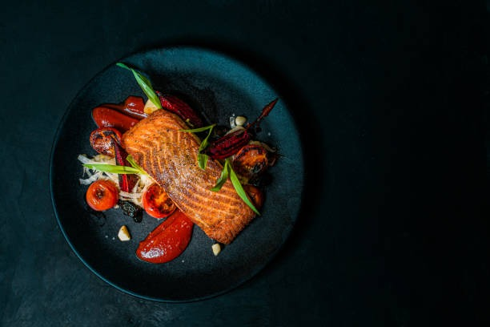

Online Food Ordering System
website
Notes:
nandini

Slide 4
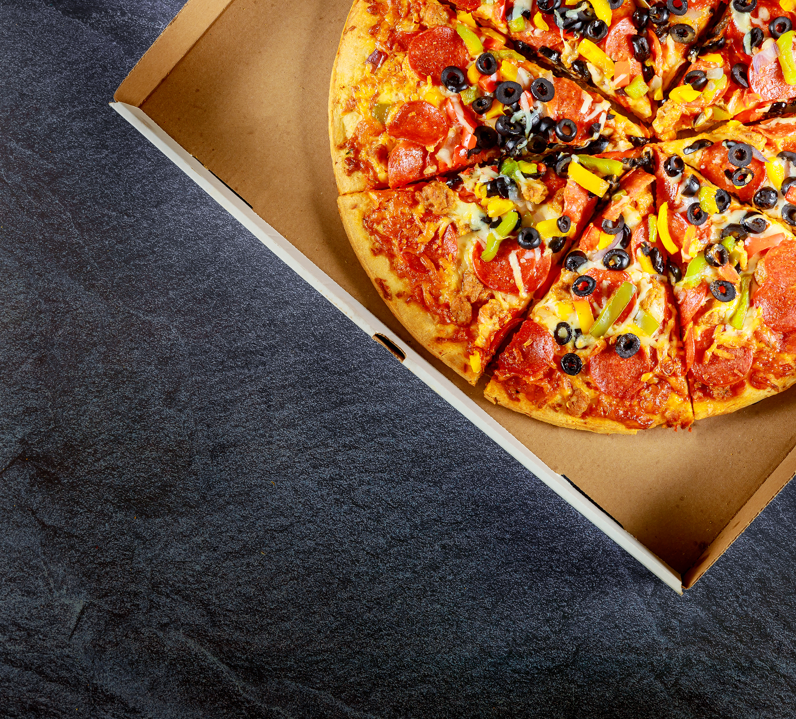
Overview
Synopsis
Abstract
Introduction
State of the art work
Objective
Problem statement
Proposed system
Existing system
UML diagrams
Output and experimentation
Conclusion
Future scope
References
Notes:
nandini

Slide 5



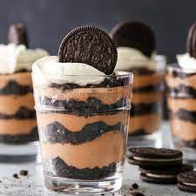
Synopsis
Online Food Ordering System Project
Front End :- HTML, CSS
Back End :- PHP
Database :- MySQL
Software used :- XAMPP
Project started date: - 18-03-2022
Notes:
shreya

Slide 6
Abstract
The online food order system is a website designed primarily for use in the food delivery industry. The system also allows to quickly and easily manage an online menu that customers can browse and use to place orders with just a few clicks. Using this website visitors can know the status of their food items and browse it based on the categories available.
Admin can manage all the categories of food like they can add, update and delete. Also can be able to manage and track food order and delivery.
Notes:
avantika

Slide 7
Introduction
Online Food ordering System is a process in which one can order various foods and beverages from some local restaurant and hotels through the use of internet, just by sitting at home or any place.
It is a simple project using PHP/MySQL. This project is developed using HTML, CSS and PHP. This project does not support any payment transaction with any third-party API. It has the admin side and visitor/client side. The admin will manage all the data needed for the website and the list of available menus. The client will browse the website, explore and choose his/her desired menu. After that, the client will go to the order, review his/ her order, confirm the delivery address and other information, and place his/ her order.
Notes:
avantika

Slide 8

Objective
The objectives of this study is as follows-
To evaluate the way of interaction with customers.
To develop a restaurant ordering system which can be managed by admin.
To display the available menu and categories to the user.
To determine the factors that influence customer when ordering food online.
To computerized the food ordering system process and display details of sales (revenue generated) in the dashboard of admin module.
Notes:
nandini

Slide 9
State of the Art Work
AUTHOR’S NAME | TITLE | JOURNAL YEAR | KEY FEATURES
T.Deepa.,Assistant professor., P.Selvamani.,Ii mcom ca | Online Food Ordering System (Pg and Research department of commerce ca Hindustan college of arts and science Coimbatore) | 2018 | Converting HTML to PHP, connecting it to the PHPMYADMIN
Tirupathi B, Rakshitha Raj R, J B Akshaya, Srilaxmi C P | Online Food Ordering System (International Journal of Recent Technology and Engineering (IJRTE)) | 2019 | Backend linking and creating admin side to update, manage.
Shahirah Mohamed Hatim, Nur Azmina Mohamad Zamani, Azham Hussain | E-Food Cart Online Food Ordering Service (International Journal of Recent Technology and Engineering (IJITEE)) | 2020 | Framework and System Implementation
Notes:
nandini

Slide 10


Problem Statement
Problem: While dining out, people had to face few problems : waiting for a long time before getting an empty table for themselves ,ordering the food which later gets unavailable and not getting a wide array of food choices in single place.
Solution: An online food ordering website
Notes:
shreya

Slide 11
Existing System
In the present scenario, people have to physically visit the hotels or restaurants for eating food and have to make payments through cash mode most of the time due to unawareness of advanced technologies in certain places.
In this method time as well as physical work is required, among which time is something that no one has in ample amount. The traditional food ordering procedure is not efficient enough for hotels and restaurants, as they have to deal with crowds, in their restaurant.
The old methods can be classified into categories which are paper grounded and verbal grounded. For paper based work, the waiter comes and pens down foods that customers order and pass the food list containing paper to the chefs or cooks in the kitchen for further process.
Notes:
avantika

Slide 12
Proposed System
This system is a bunch of benefits from various point of views. As this online application enables the end users to select the food items of their choice from the menu list, and order food online.
The selection made by the customers will be available to the admin or to the person handling work assignment.
Now this same person will assign the orders to the specialist chef to be completed within a fixed duration of time.
Notes:
avantika

Slide 13
System design:
User side module
Admin side module
Food Search
Category
Food menu
Social navigation
Contact
Admin login
Dashboard
Manage admin
Manage category
Manage food
Manage order
Notes:
nandini

Slide 14
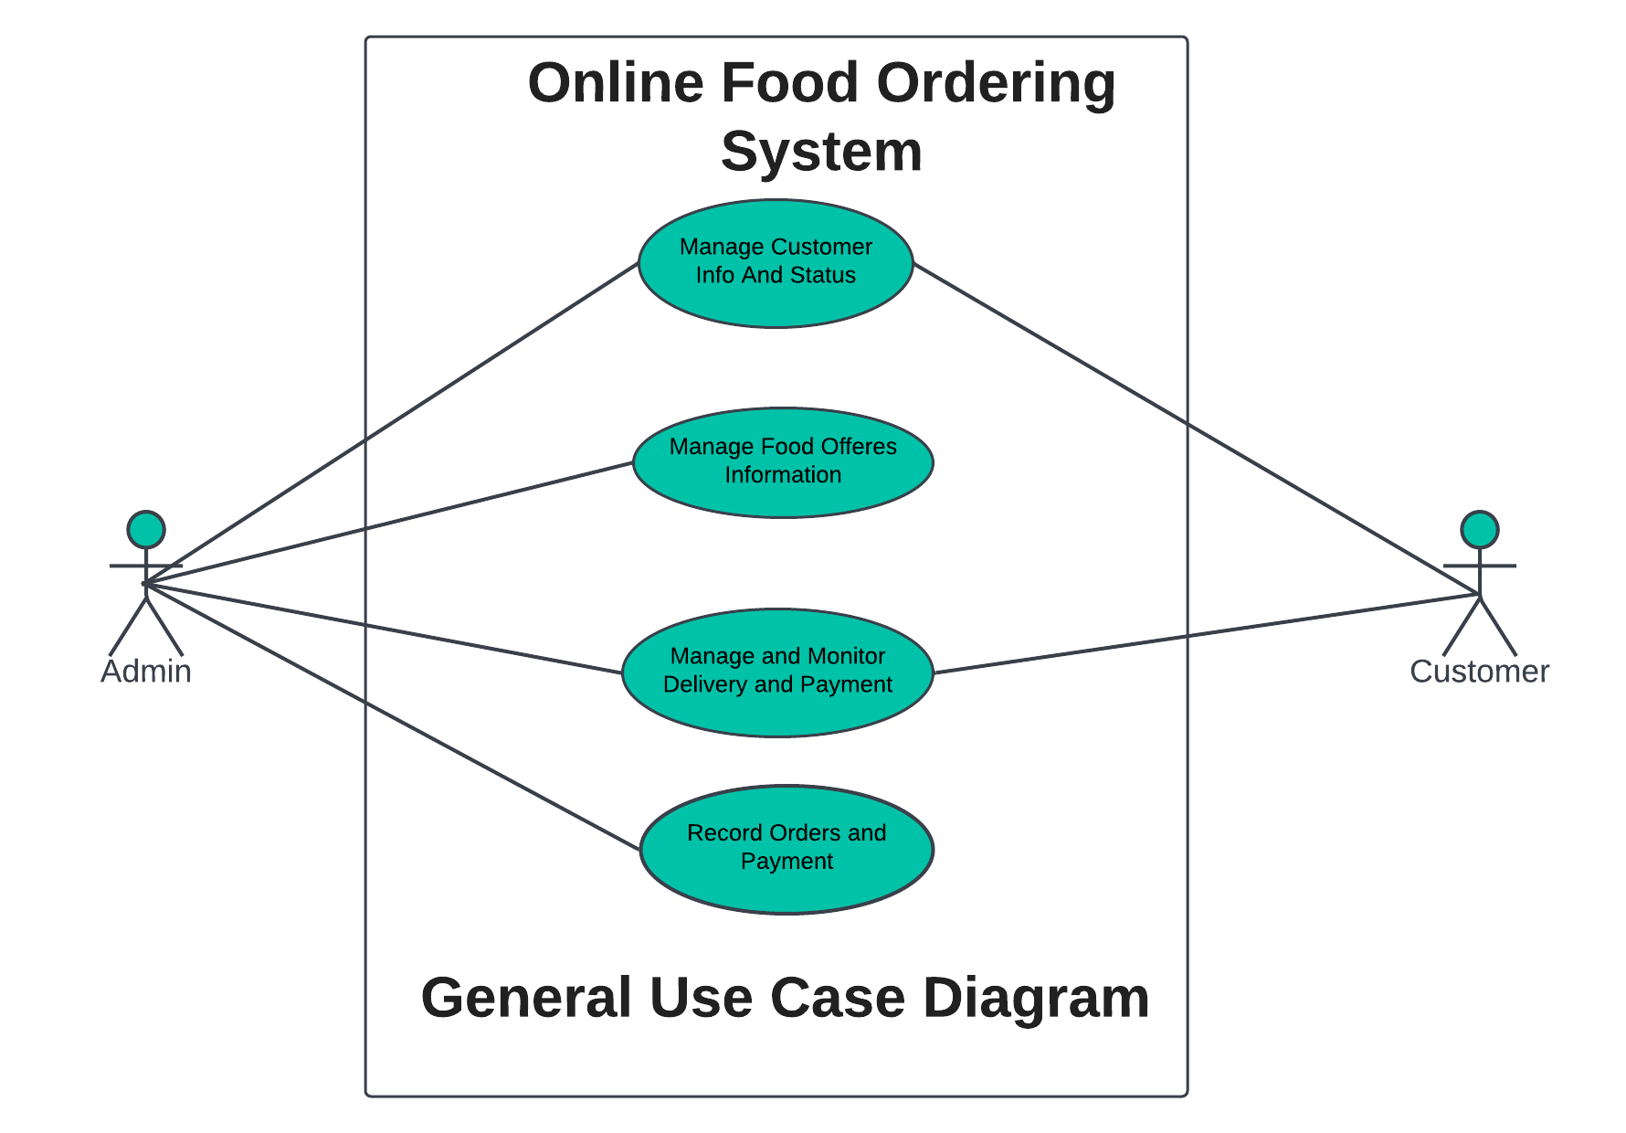
USE CASE DIAGRAM
Manage/Monitor Orders and Info
Record Order Deliveries and status
Notes:
shreya

Slide 15
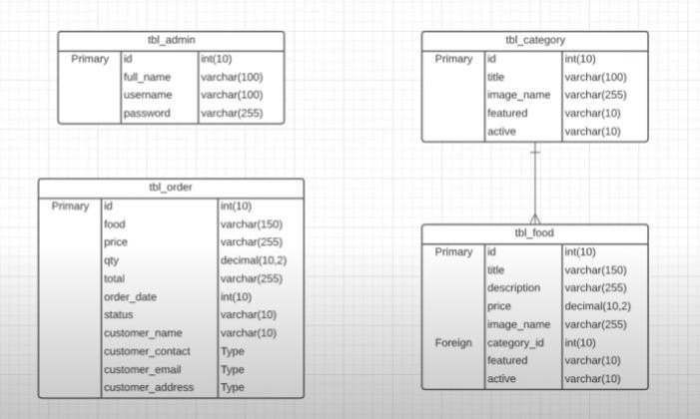
Class Diagram
Notes:
shreya

Slide 16
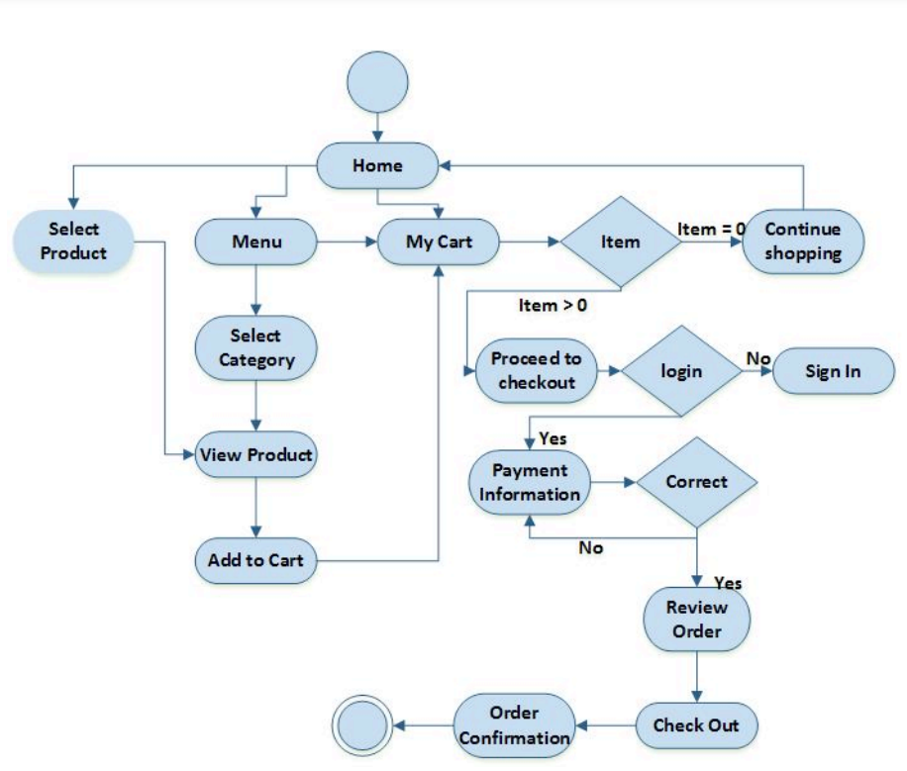
Activity Diagram
Admin
Admin
Order Status
View order
Notes:
shreya

Slide 17
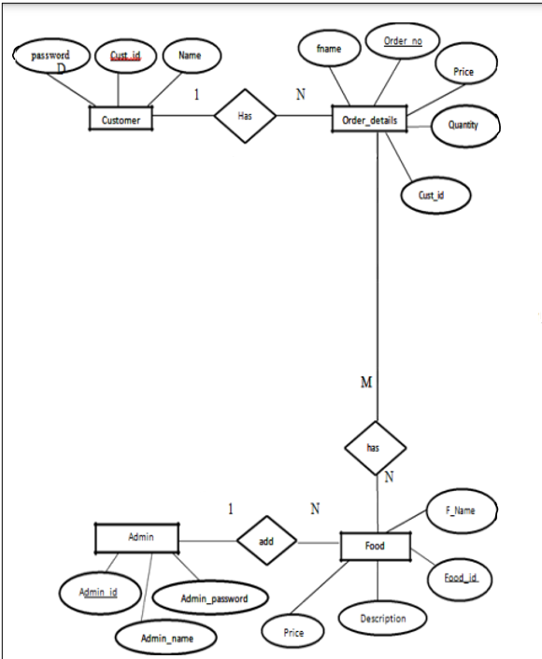
ER Diagram
Notes:
shreya

Slide 18
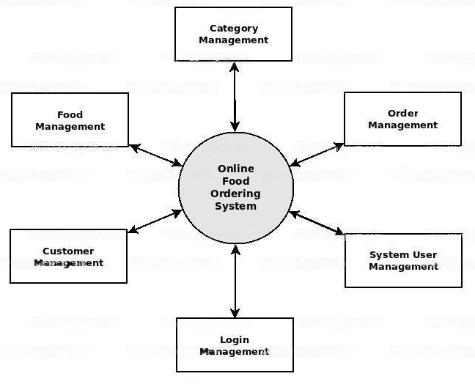
Dataflow Diagram
Notes:
shreya

Slide 19
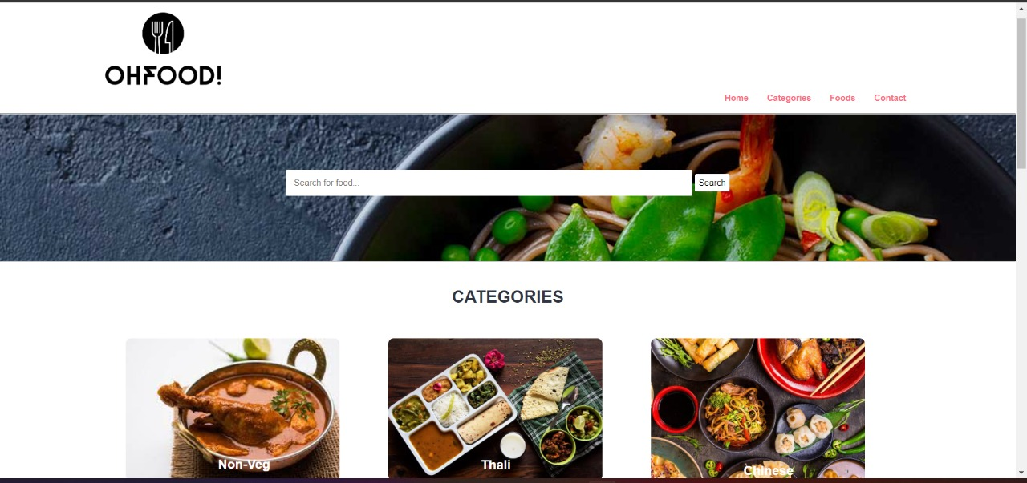
Website : home page
Notes:
Nandini
Front page:4 parts

Slide 20
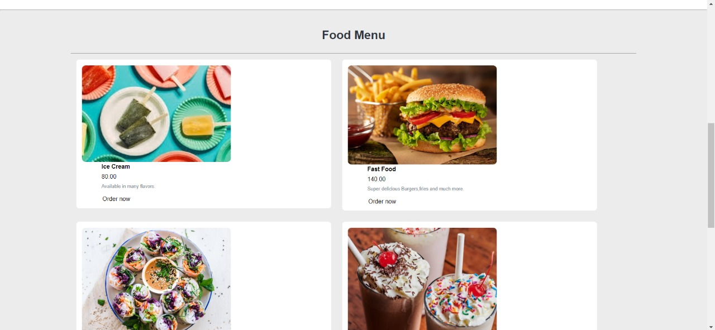
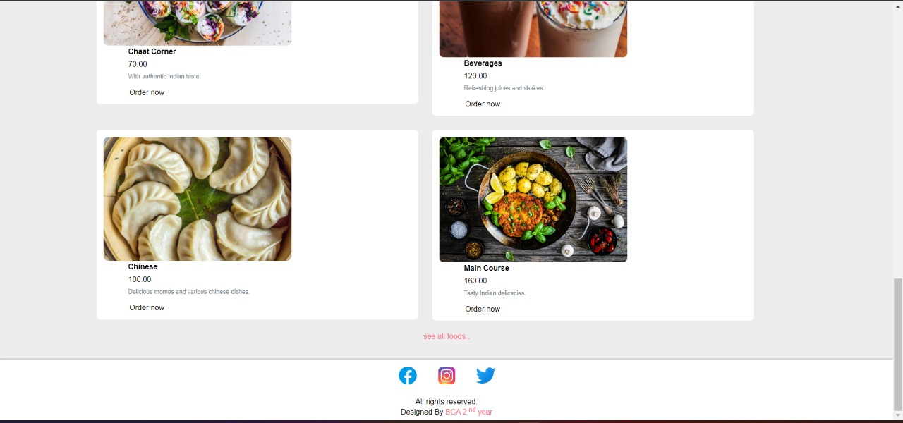
FOOD MENU
Notes:
NANDINI

Slide 21
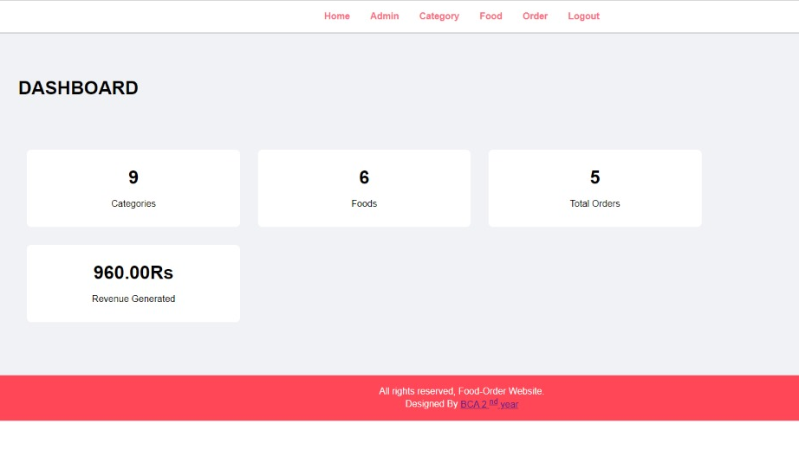
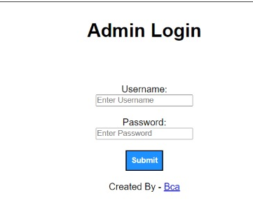
Admin Side
Notes:
shreya

Slide 22
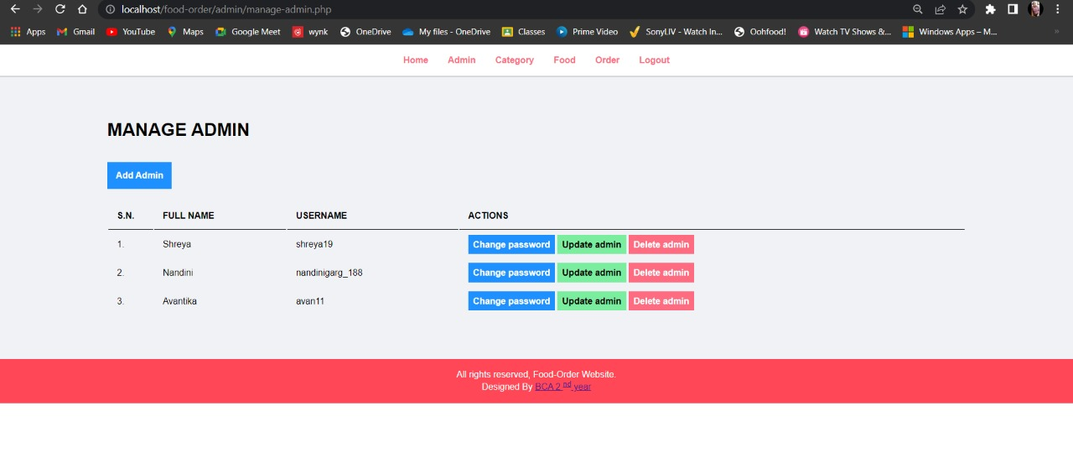
Admin Side: MANAGE ADMIN
Notes:
shreya

Slide 23
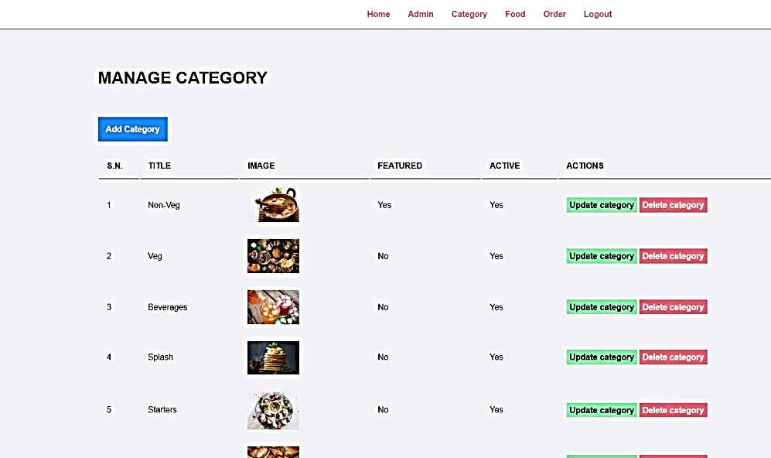
MANAGE CATEGORY

Slide 24
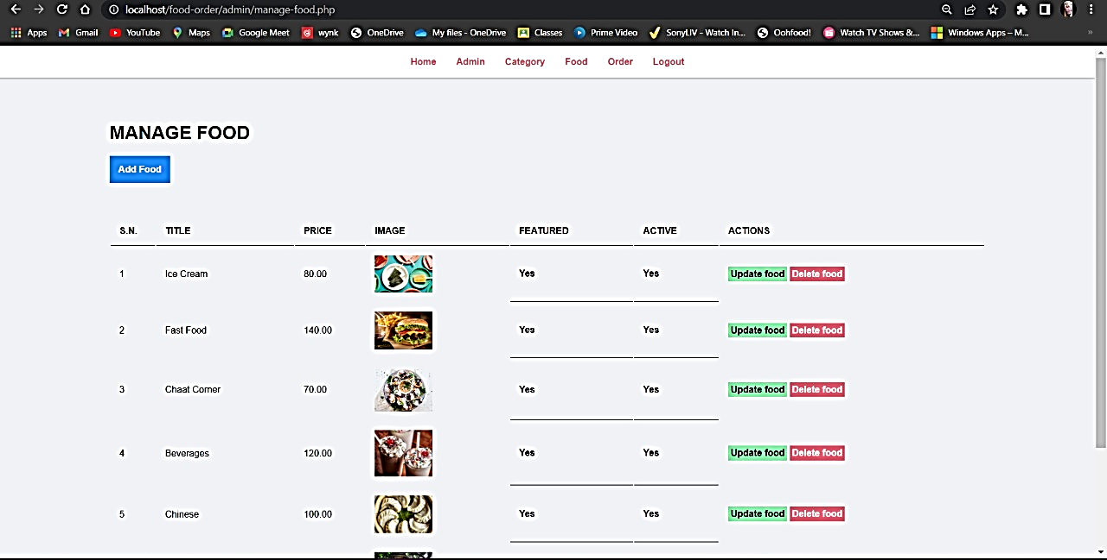
MANAGE FOOD

Slide 25
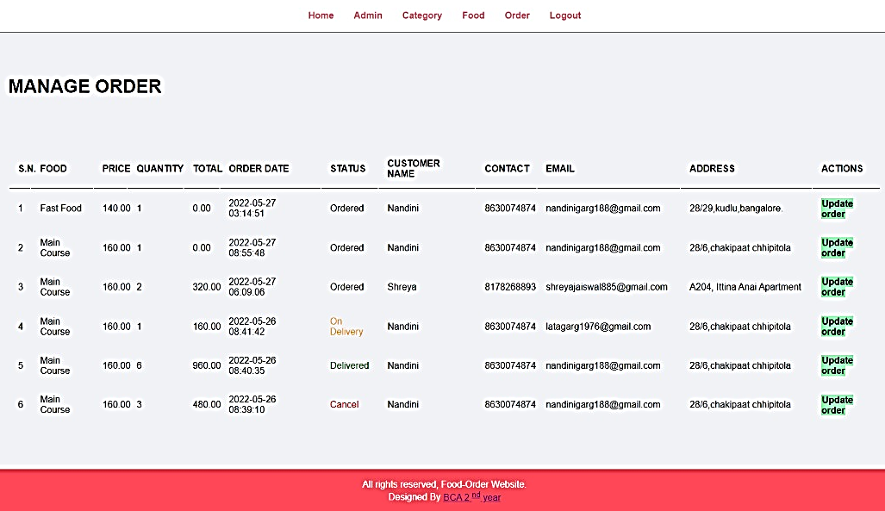
MANAGE ORDER
Notes:
shreya

Slide 26
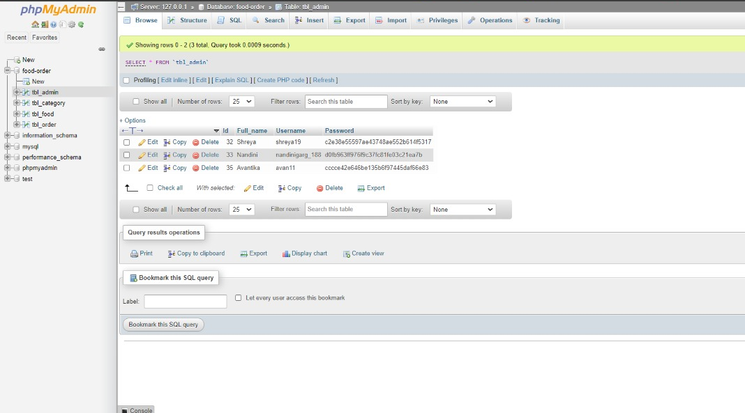
Database
Notes:
nandini

Slide 27
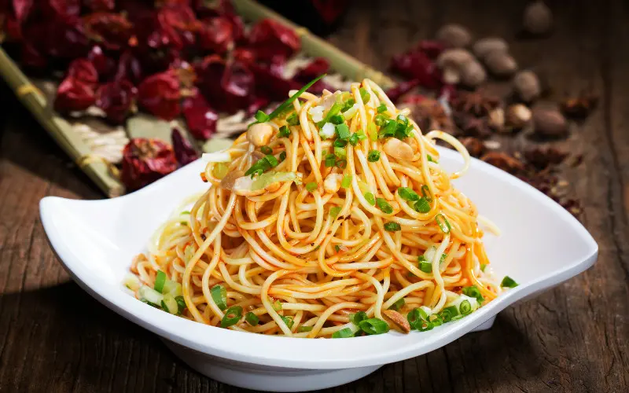
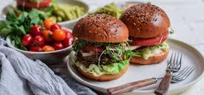
Conclusion
An online food ordering system is developed where the customers can make an order for the food and avoid the hassles of waiting for the order to be taken by the waiter. Using the application, the end users register online, read the E-menu card and select the food from the e-menu card to order food online. Once the customer selects the required food item the chef will be able to see the results on the screen and start processing the food. The system also enables the restaurant to know the items available in real time and make changes to their food and beverage inventory based on the orders placed and the orders completed.
Food Ordering Website
Notes:
avantika

Slide 28
Future Scope
This online food system project aimed at developing an online food ordering system that can be used in small places, and medium cities firstly and then on a large scale.
Points to be introduced in future work:
Security for PHP to prevent it from unauthorized person
Mobile Responsive
Payment method
Customer login module
Cart inclusion
Notes:
avantika

Slide 29
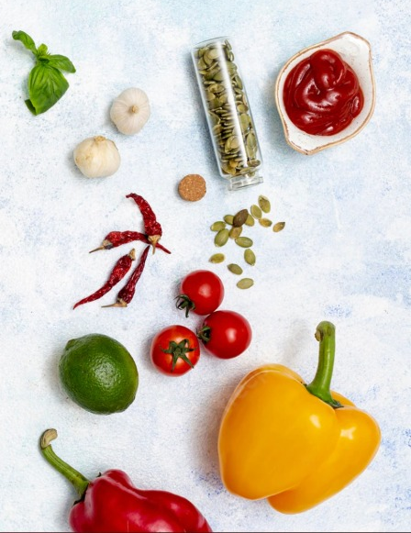
References
Online Food Ordering System
(Pg and Research department of commerce ca Hindustan college
of arts and science Coimbatore)
2. Online Food Ordering System
(International Journal of Recent Technology and Engineering (IJRTE))
3. E-Food Cart Online Food Ordering Service
(International Journal of Recent Technology and Engineering (IJITEE))
4. Php code [online] available at www.w3schools.com
5. Mysql code [online] available at www.stackoverflow.com
Food Ordering Website
Notes:
avantika

Slide 30


Thank you
BCA 2nd Year
Notes:
avantika

